Slide 1
Work summary - Bao Vuong, Azuresnow
I created the basis for a UI layout with a login button when clicked a login popup will appear prompting users to either login or sign up
A create events button which isn’t functional yet
A darkmode button which isn’t functional either

Slide 2
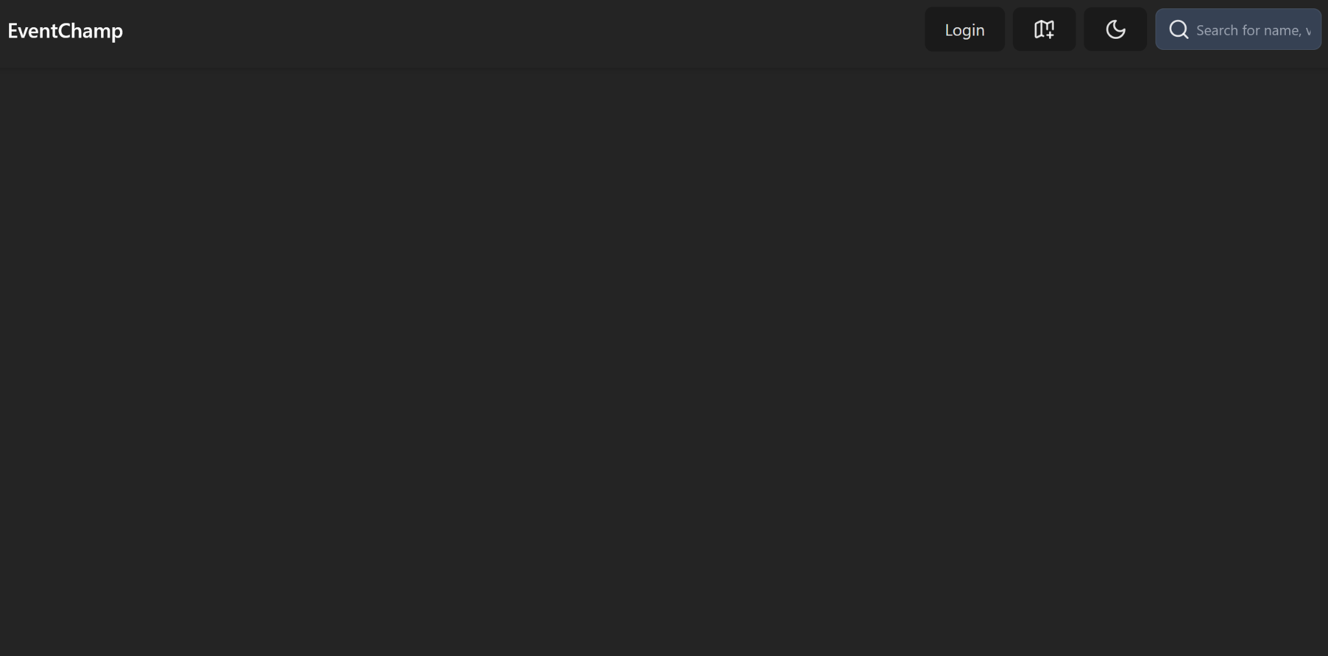
UI explanation
Top right we have all our buttons

Slide 3
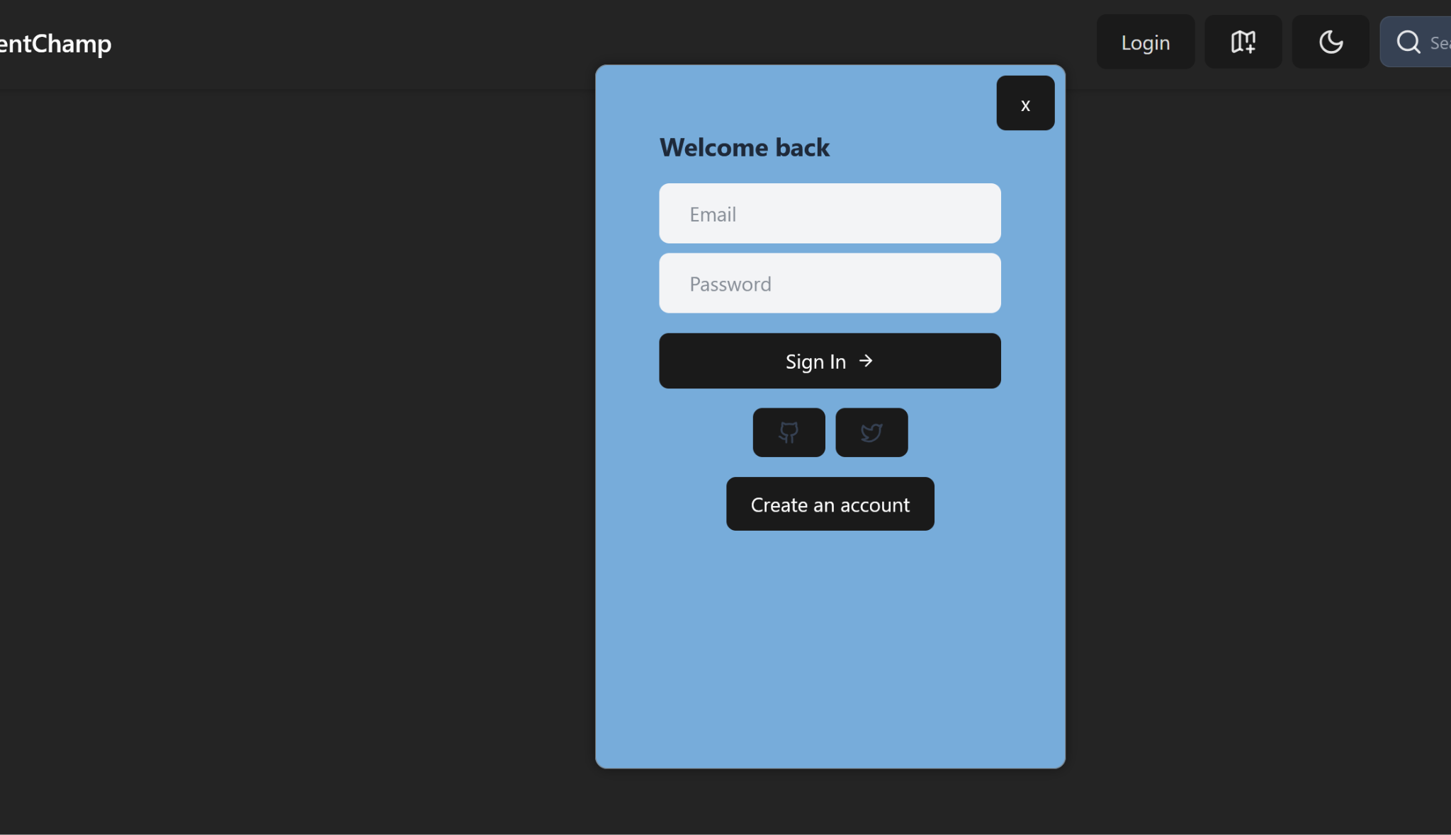
UI explanation continued
Clicking login will prompt users to login

Slide 4
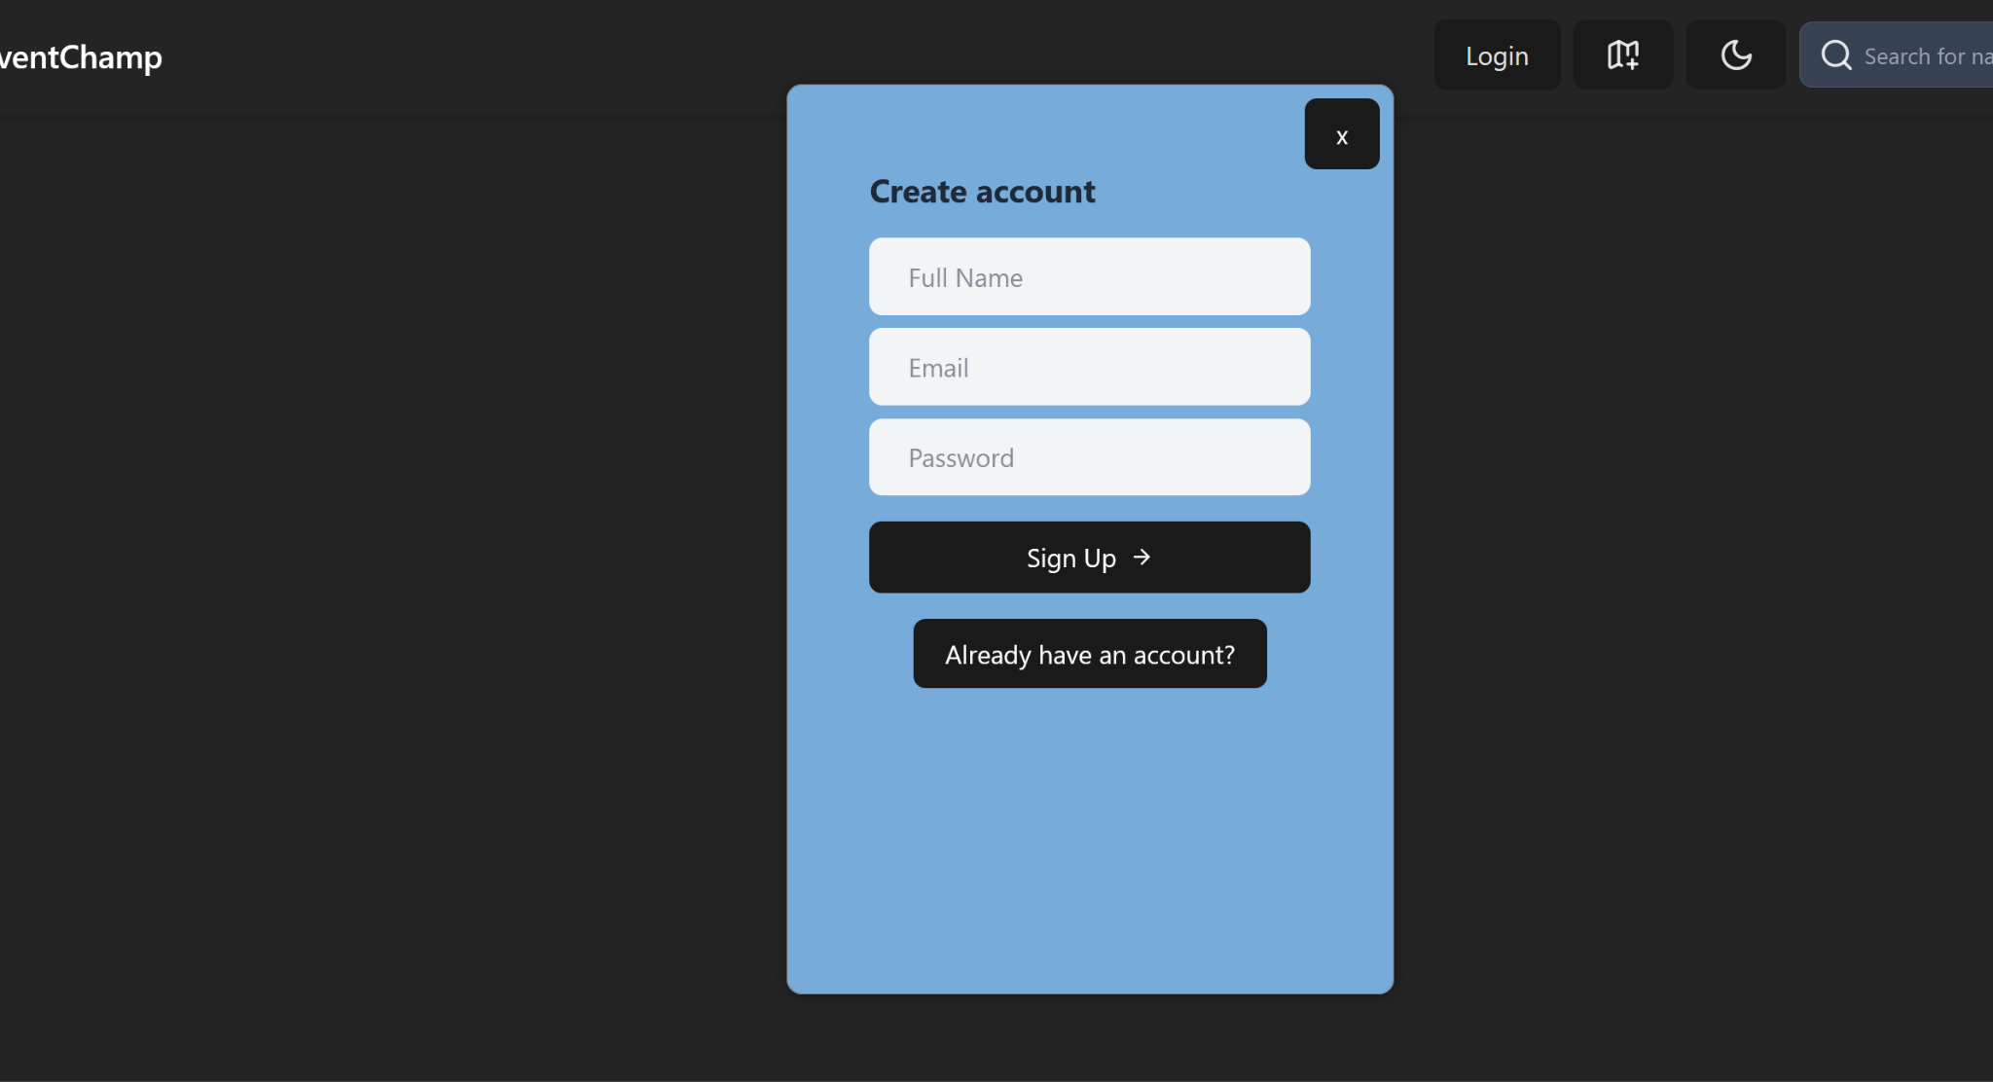
UI explanation continued
Clicking create an account will change the login popup to a create an account form

Slide 5
Challenges and insights
It was a bit difficult to align the UI
Users will be able to quickly navigate our website because all of the important buttons are easily accessible through the navbar
Users won’t be redirected to a login or signup page since they’re part of the same page.

